Slide 1

IST 597: Foundations of Data Privacy Introduction and course expectations
Week 1
January 10, 2021
w/ some slides courtesy of Joe Near, UVM, Anna Squicciarini, PSU

Slide 2
What is your definition of privacy?

Slide 3
1. Privacy as Control
(Westin, 1968) “The claim of individuals, groups, or institutions to determine themselves when, how and to what extent information about them is communicated to others.”
(Altman, 1975) “The selective control of access to the self or to one’s group.”
(Warren and Brandeis, 1980) The right to privacy is the right to be let alone.
---> Reflect privacy as an inherent precondition for autonomy.
and others..

Slide 4
How do you give people control over their personal information?

Slide 5
Notice and Consent
People should be informed about how organizations/others plan to store, use or exchange their personal data, and they should be asked for consent.

Slide 6
(Solove, 2012) Privacy self-management and the “consent dilemma”:
→ Argues that privacy self-management does not provide meaningful control.
“There are too many entities collecting and using personal data to make it feasible for people to manage their privacy separately with each entity. Moreover, many privacy harms are the result of an aggregation of pieces of data over a period of time by different entities. It is virtually impossible for people to weigh the costs and benefits of revealing information or permitting its use or transfer without an understanding of the potential downstream uses.... In addition, privacy self-management addresses privacy in a series of isolated transactions guided by particular individuals. Privacy costs and benefits, however, are more appropriately assessed cumulatively and holistically — not merely at the individual level.”

Slide 7
2. Privacy as Contextual Integrity
(Nissenbaum, 2011) Privacy is adherence to expected flows of personal information, modeled with the construct of context-relative informational norms.
Context = Structured social settings (“Institutions”) characterized by roles, relationships, power structures, canonical activities, strategies, norms (rules), enforcement mechanisms, and internal values (goals, ends, purposes)
E.g., healthcare, education, politics, religious observance

Slide 8
Information
of a certain type
about a subject
from a sender
to a recipient
is governed by transmission principles.
E.g., consent, notice, compulsion, confidentiality, sale, barter, entitlement, reciprocity, need, secrecy,…

Slide 9
Legal Frameworks invoke CI implicitly
Privacy conversations are often framed by expectations of privacy.
In fact, the “reasonable expectation of privacy” is a legal test crucial in defining scope of acceptable surveillance.
Reasonable expectation often comes down to context.
E.g., hotel room vs. street corner
Highly dynamic in today’s technology landscape!
Walking down the street, one could argue you could expect to be watched. But, should you also expect to be:
Identified (e.g., facial recognition)
Tracked (e.g., mobile-phone tracking)
Recorded (e.g., audio bugging, infrared cameras)

Slide 10
On the Internet, you might share information in a public forum. But, should you expect this information be harvested, aggregated, analyzed, and used for specific purposes (not intended by you)?

Slide 11
Ubiquitous computing and ambient intelligence
And their potential threats to contextual integrity
Ubiquitous computing – Embedding micro-processors into everyday working and living environments in an invisible and unobtrusive way.
Ambient intelligence – An advanced form of ubiquitous computing that incorporates wireless communication and intelligent user interfaces, which use sensors and intelligent algorithms for profiling and context awareness.
Imagine: People are surrounded with possibly hundreds of intelligent, networked computers that are aware of their presence, personality and needs, and perform actions or provide information based on their perceived needs.

Slide 12
Once we’ve established what information could/should be shared, how do we assure that’s (all) we’re sharing?

Slide 13
Protecting data privacy
Naive Anonymization
Group-based anonymization (e.g., K-anonymity)
Cryptographic-based approaches
Differential Privacy
Module 2
Advanced Topics
Module 3

Slide 14
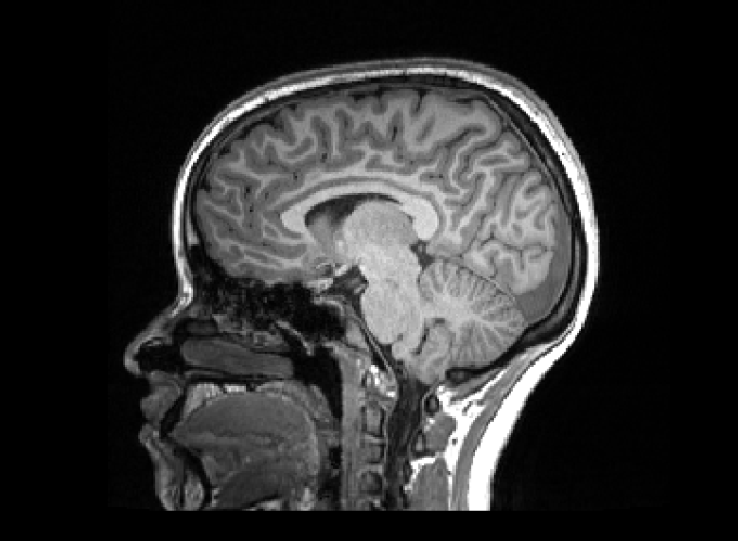
Protecting PII is nontrivial
Rule of thumb: The richer the dataset, the more that can be inferred (or pieced back together)

Slide 15
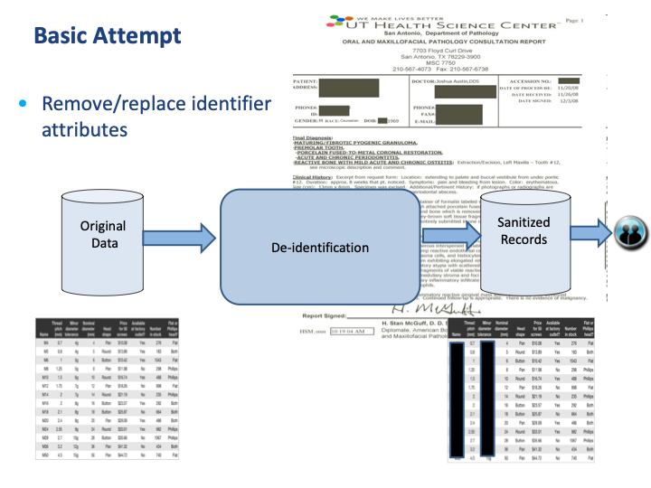
Naive Anonymization

Slide 16
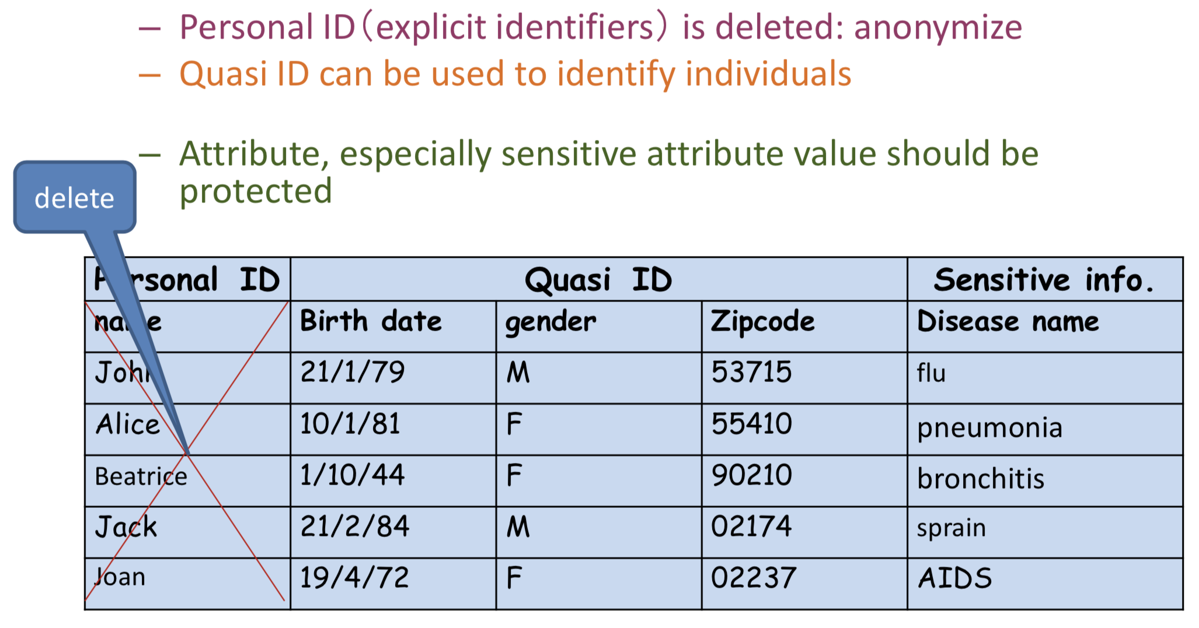
Re-identification Attacks
“Quasi-ID” can be used to identify individuals (given auxiliary data)
Image: Hiroshi Nakagawa, U of Tokyo

Slide 17
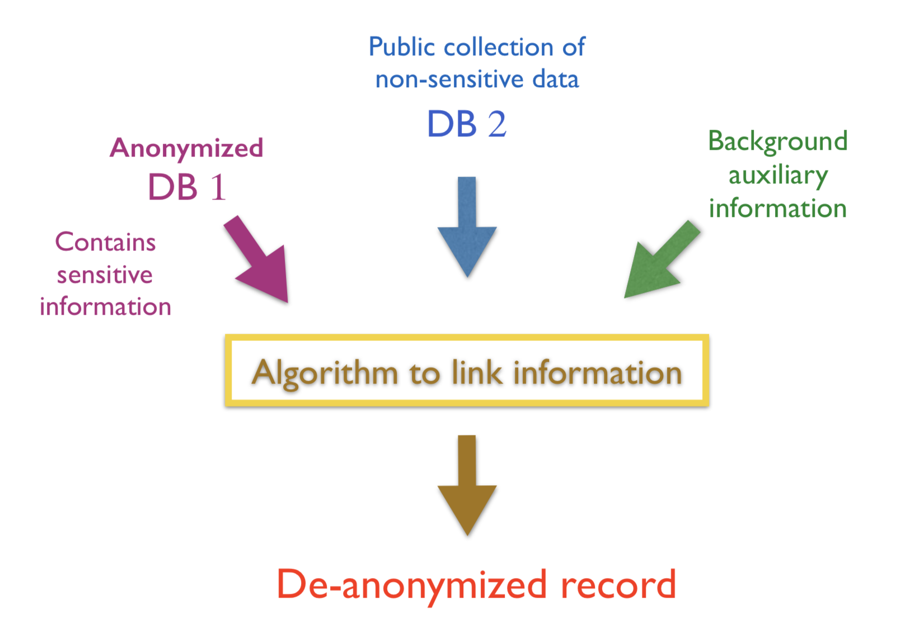
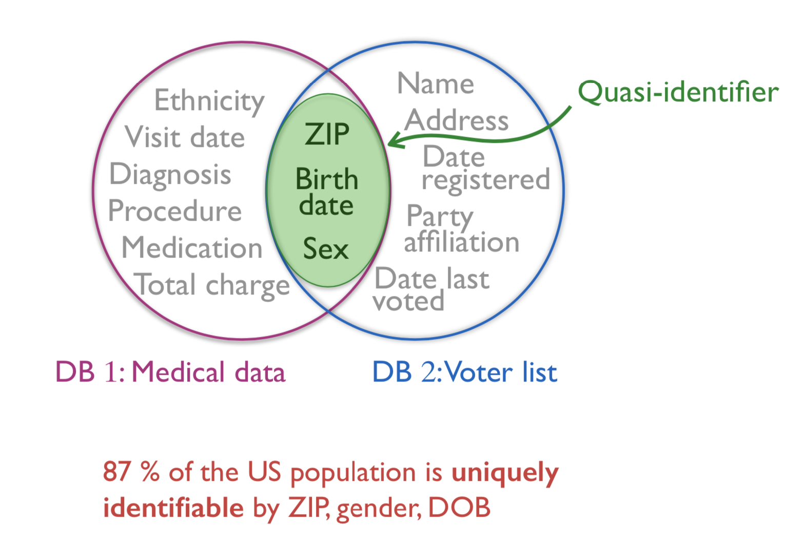
Sweeny’s re-identification Attack by linking
Images: Catuscia Palamidessi, INRIA

Slide 18
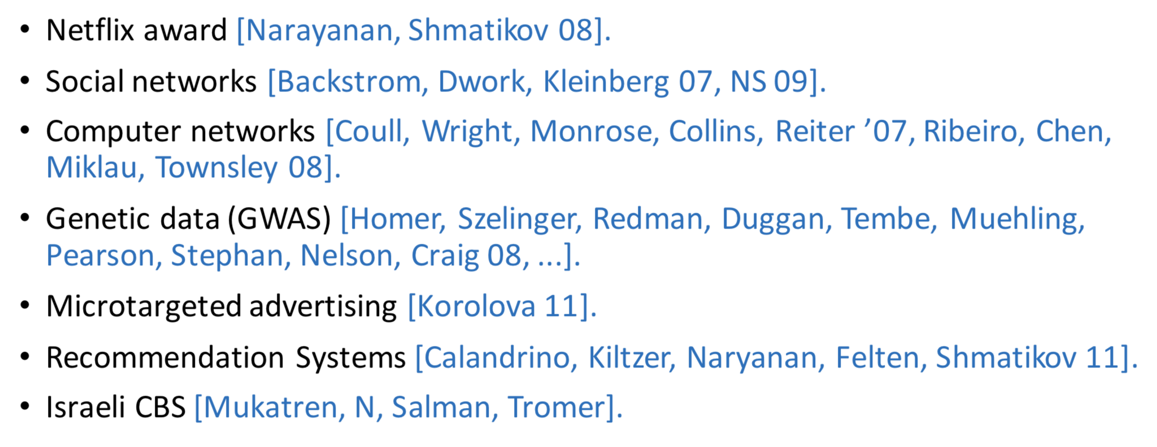
More examples of a re-identification
Netflix released movie-ranking data with names replaced by random numbers and some shifting of personal details. Narayan and Shmatikov re-identified (68% accuracy) by comparing with non-anonymous IMDB.

Slide 19
The Anonymous City
https://vous-etes-ici.net/the-spectre-of-anonymity/
The promise of anonymity is impossible to fulfill if individual records happen to contain information – that falls outside the scope of commonly defined personally identifiable information (PII) – but that nevertheless distinguishes a person or individual.

Slide 20
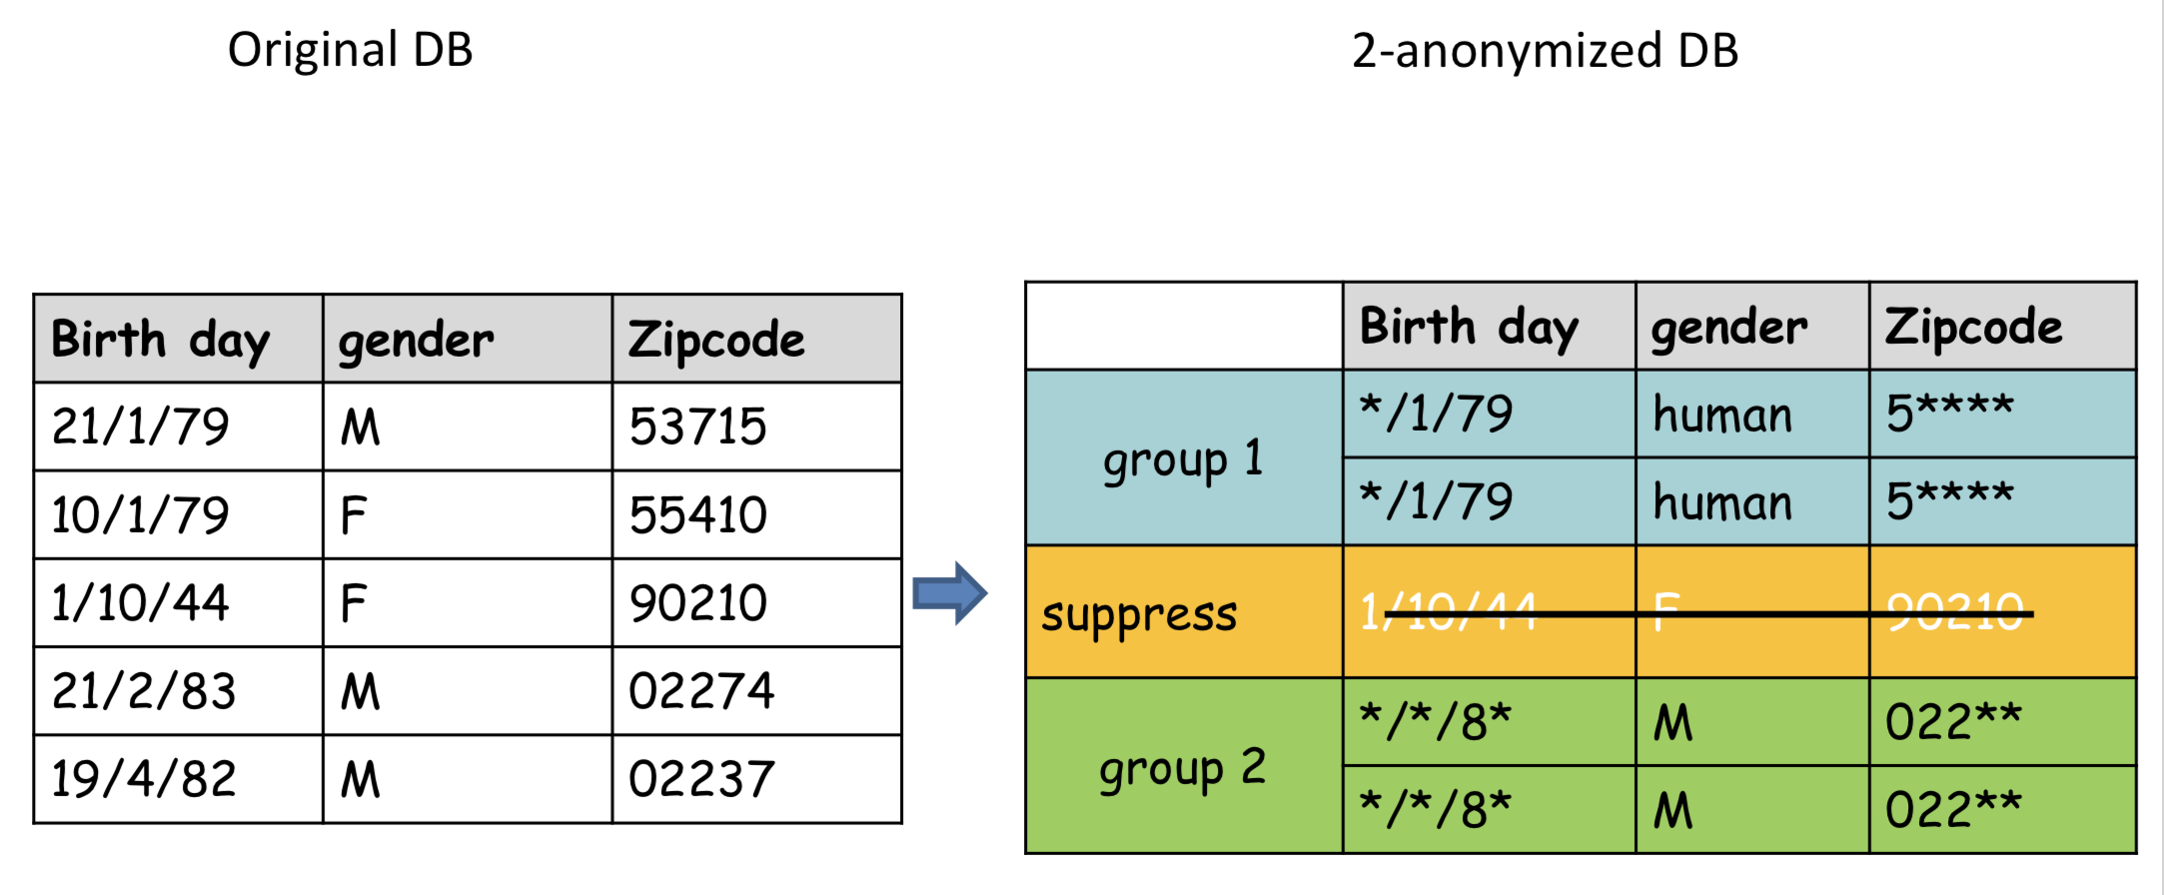
K-Anonymization
Attributes are suppressed or generalized until each row in the database is identical with at least k-1 other row. → “At worst”, the data released narrows down an individual entry to a group of k individuals.
Image: Hiroshi Nakagawa, U of Tokyo

Slide 21
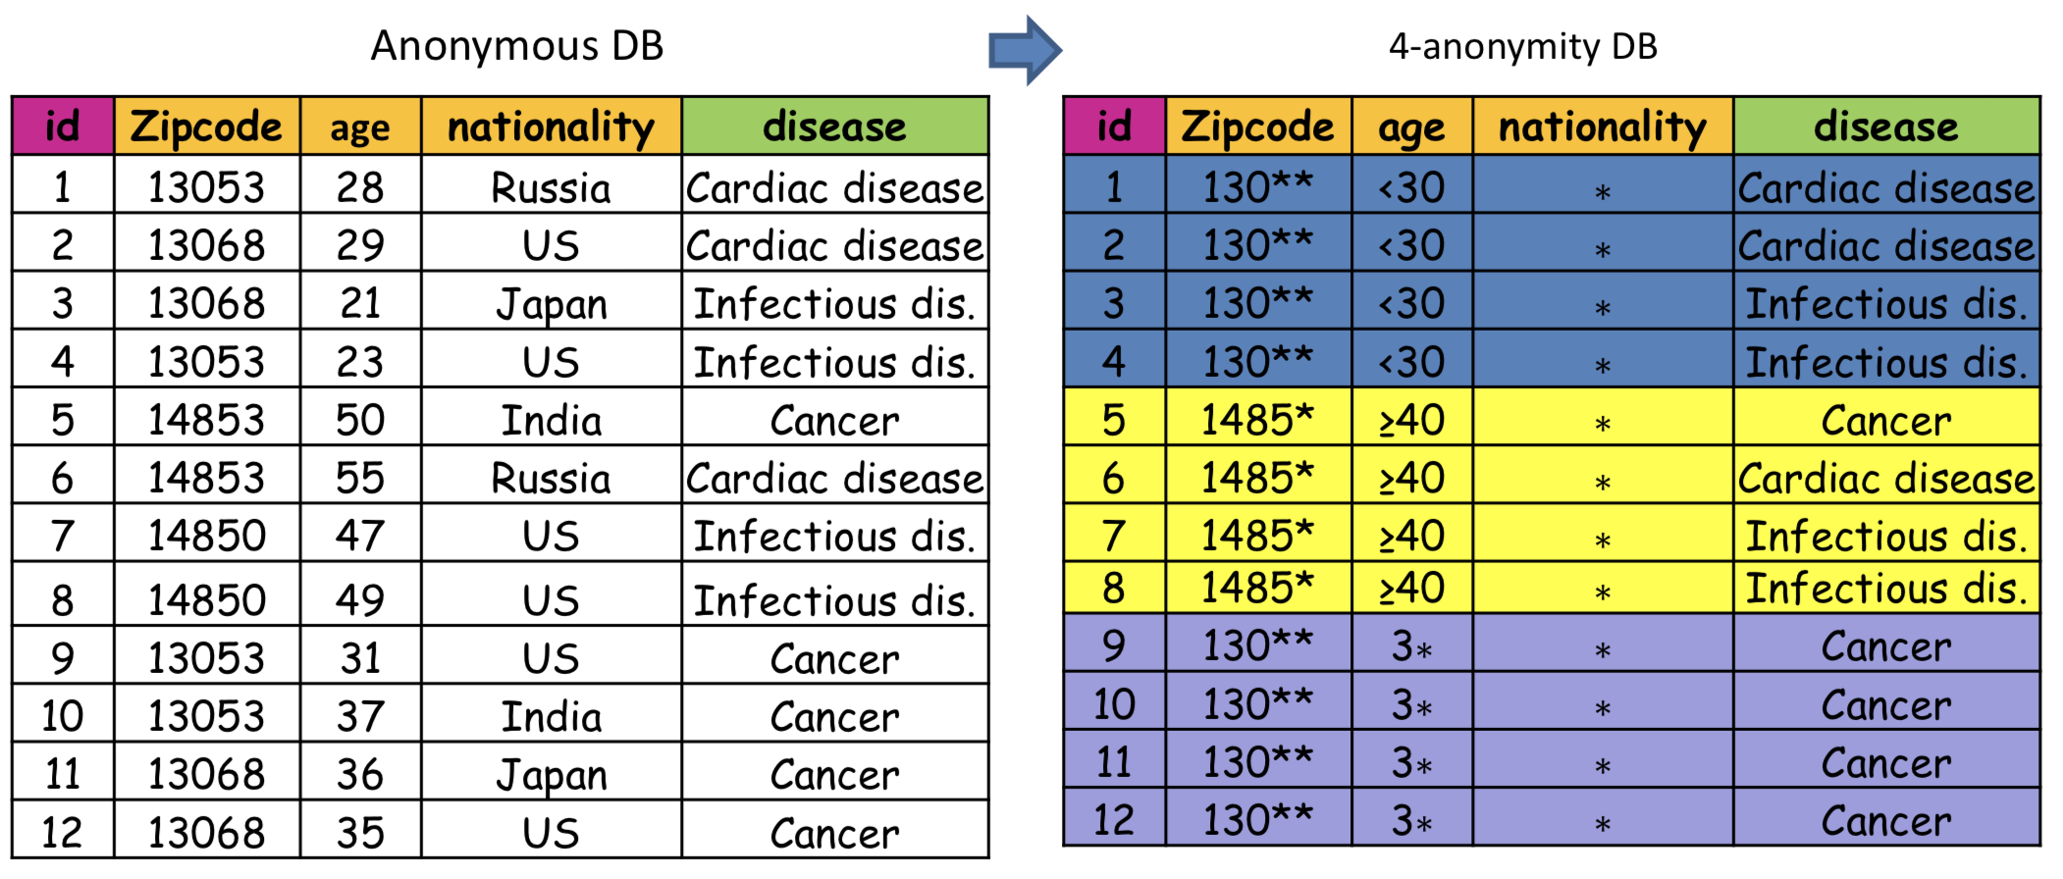
Attacks on K-Anonymization
E.g., Homogeneity attack, Background knowledge attack
Image: Hiroshi Nakagawa, U of Tokyo

Slide 22
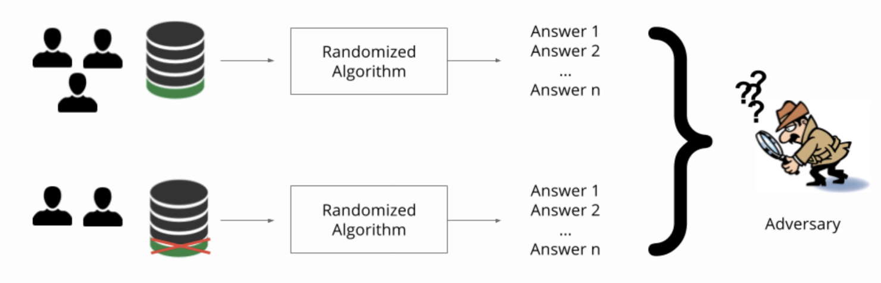
Toward a solution: Differential Privacy (DP)
Aim: Develop a mechanism whose output is nearly unchanged by the presence of absence of a single respondent in the database.
Key idea: Add controlled noise (following a specific distribution) to hide the impact of a single network trace.
http://www.cleverhans.io/privacy/2018/04/29/privacy-and-machine-learning.html

Slide 23
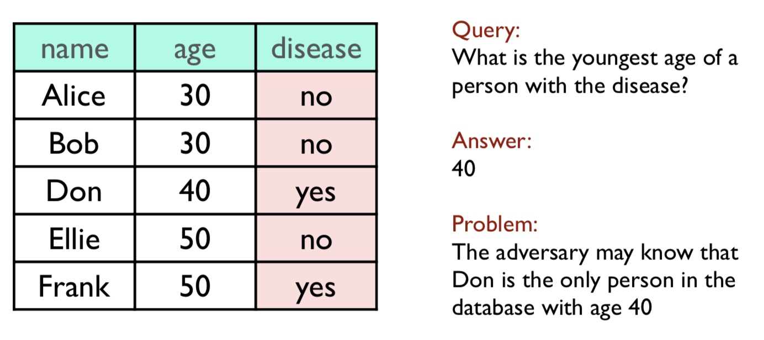
DP: an example
In a medical database, we may want to ask queries that help to figure the correlation between disease and age, but we want to keep private information about whether a certain person has the disease.
Example: Catuscia Palamidessi, INRIA

Slide 24
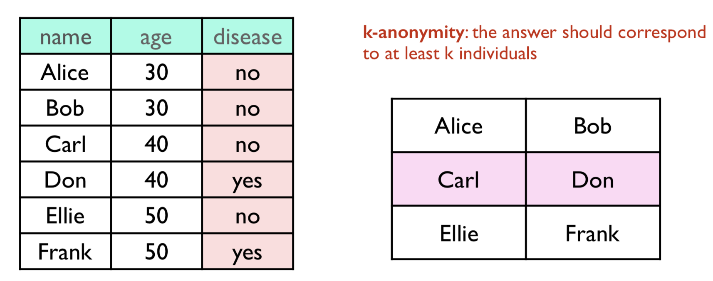
Statistical queries should not reveal private information, but it is not straightforward to prevent such a breach.

Slide 25
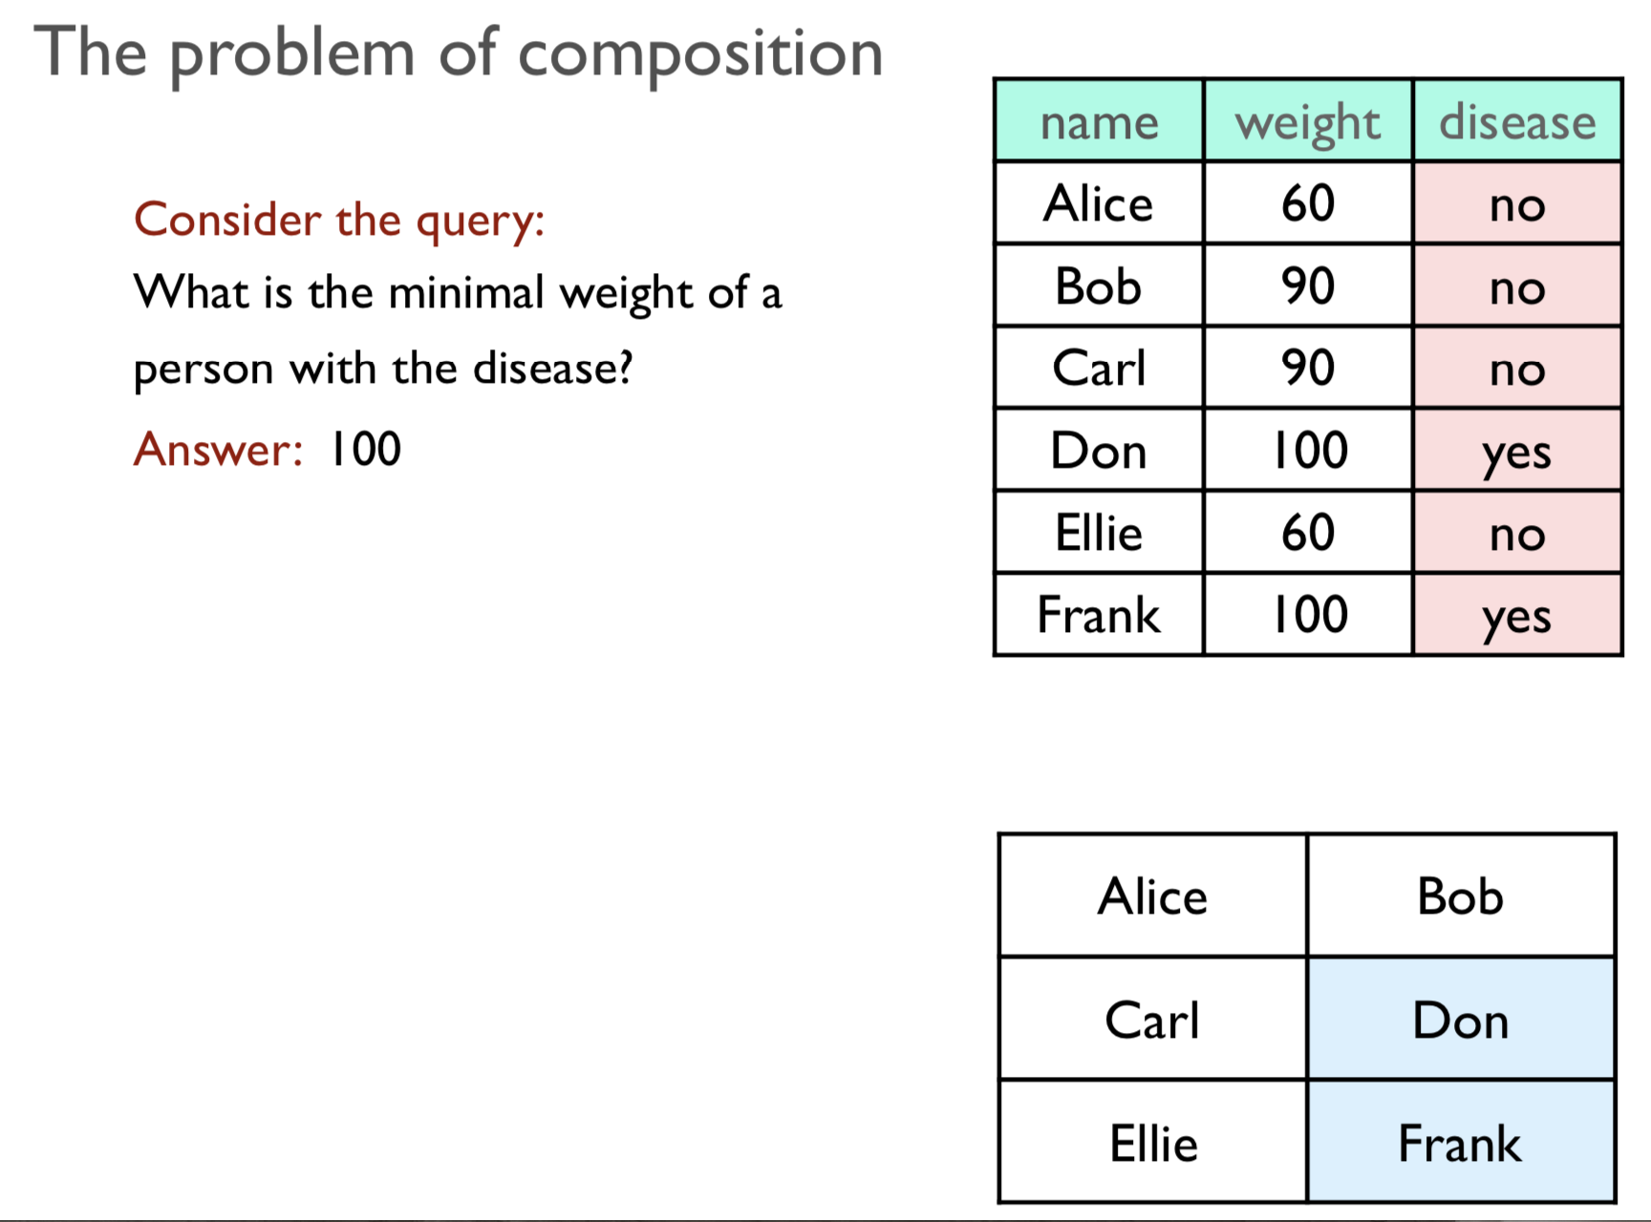

Slide 26
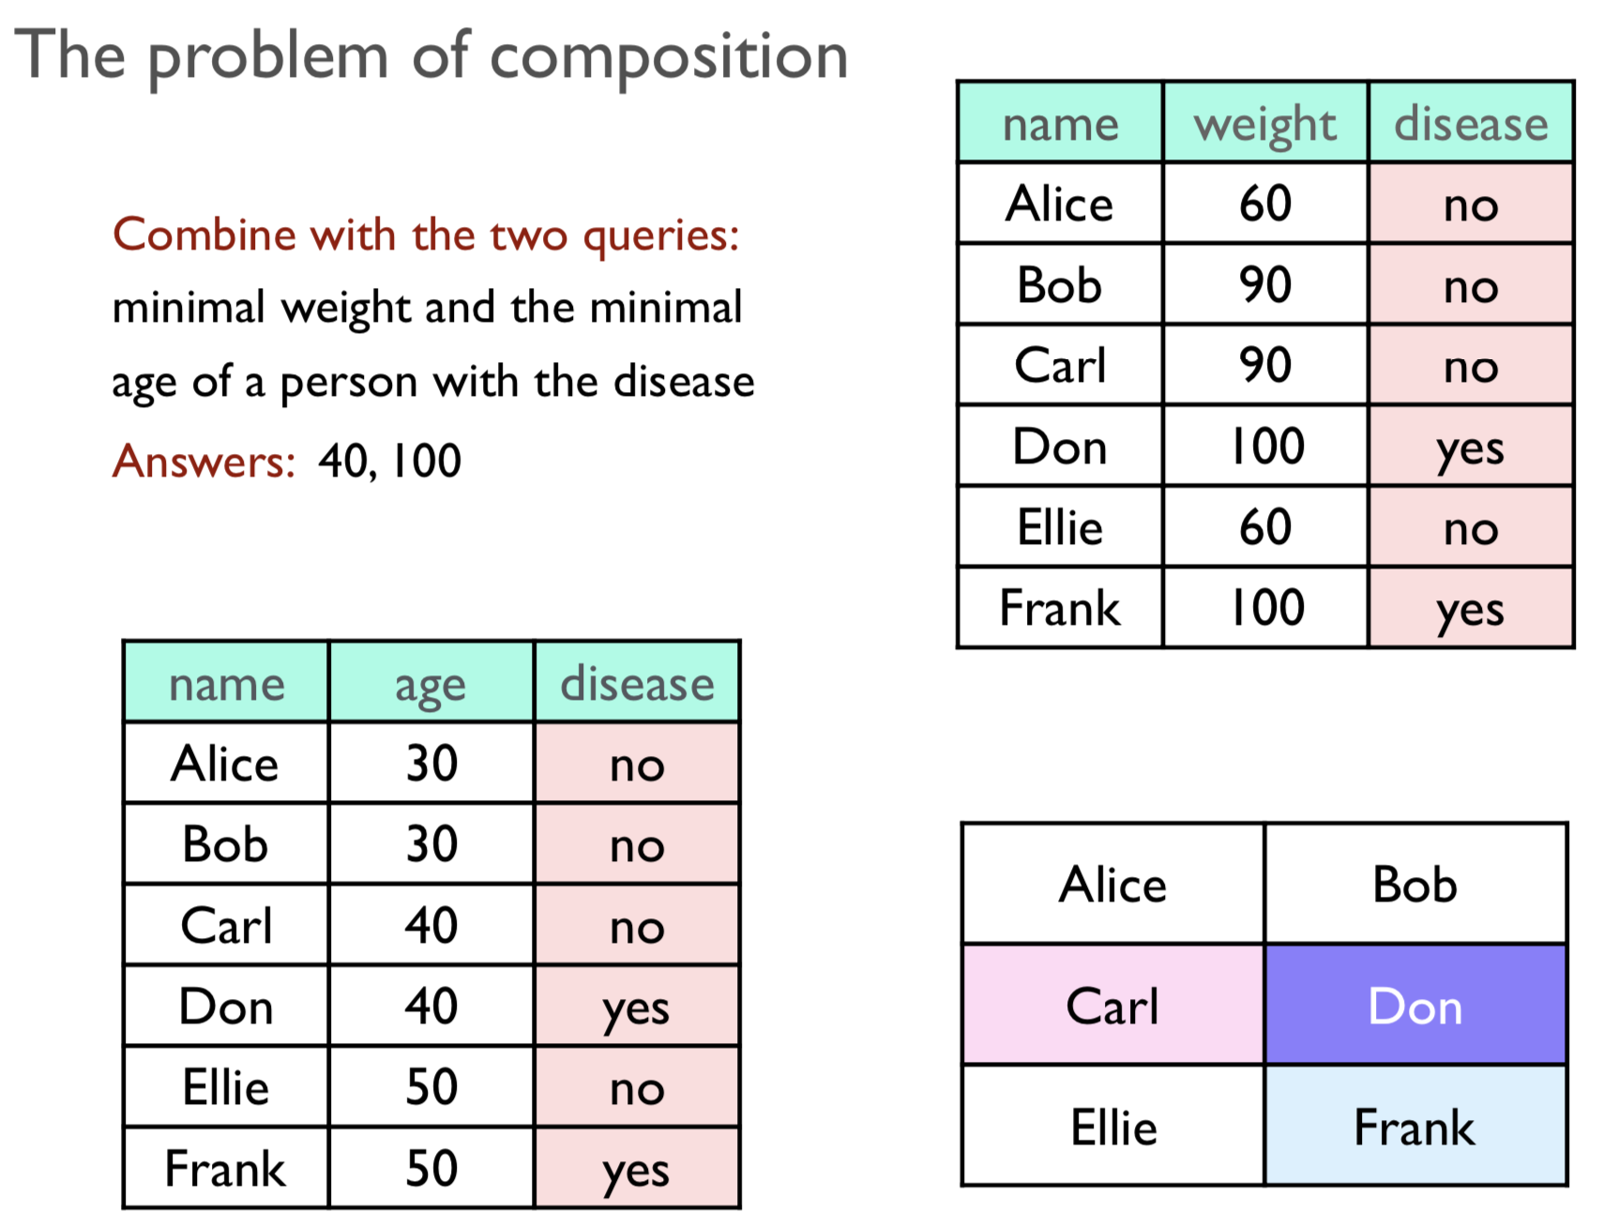

Slide 27
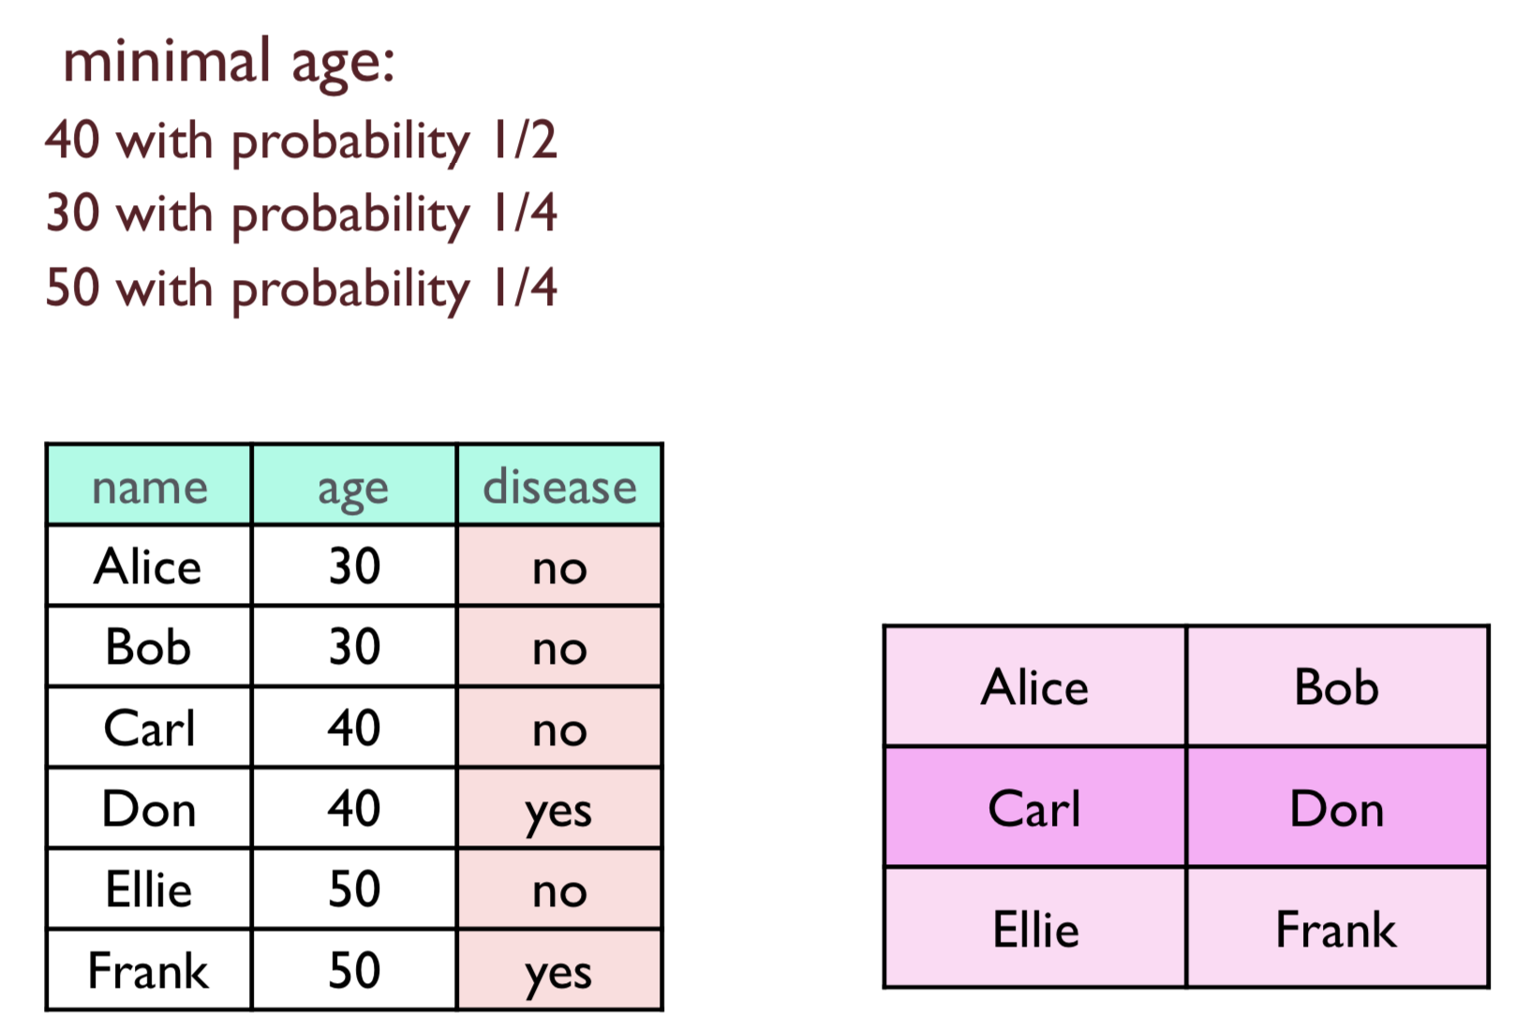
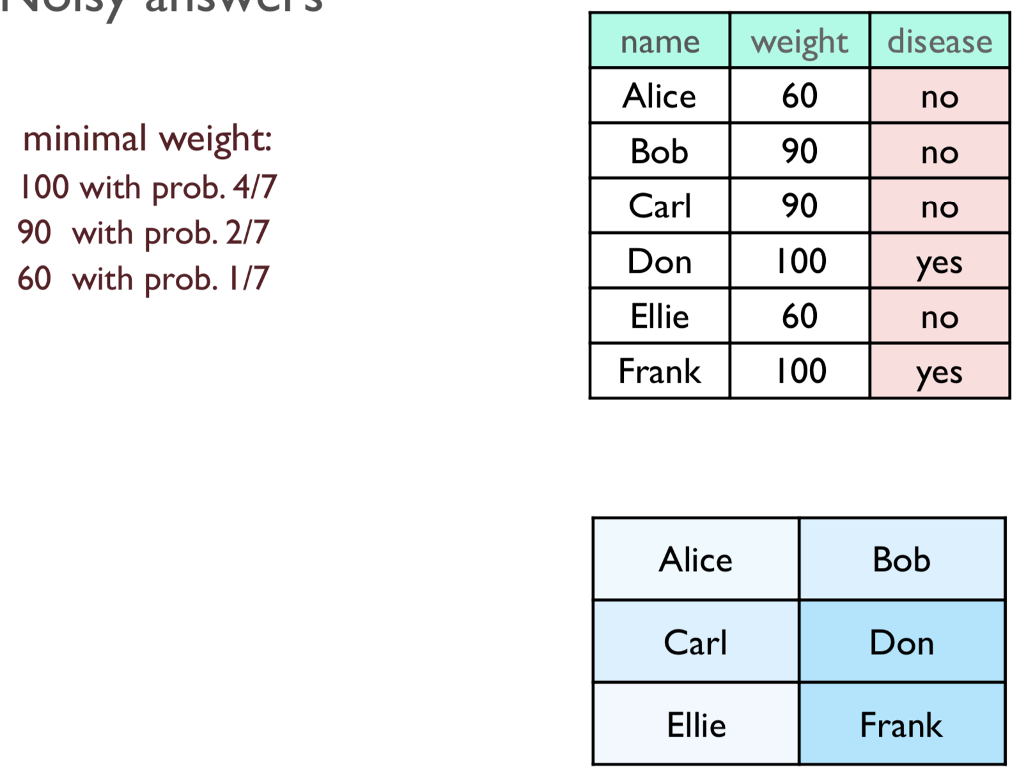

Slide 28
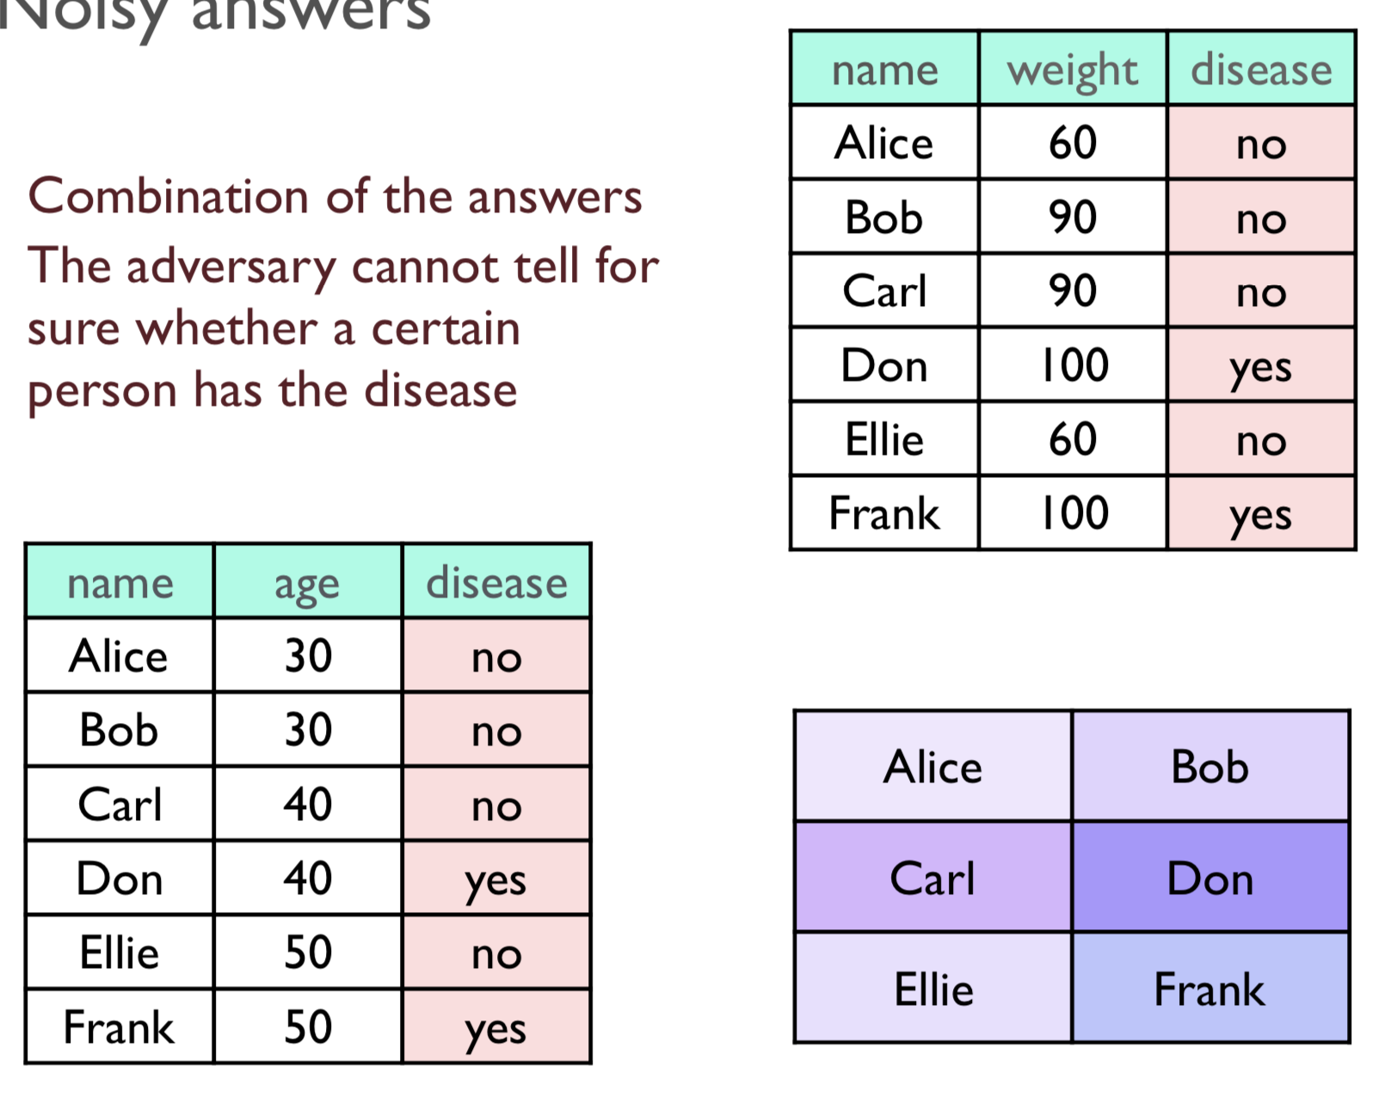

Slide 29
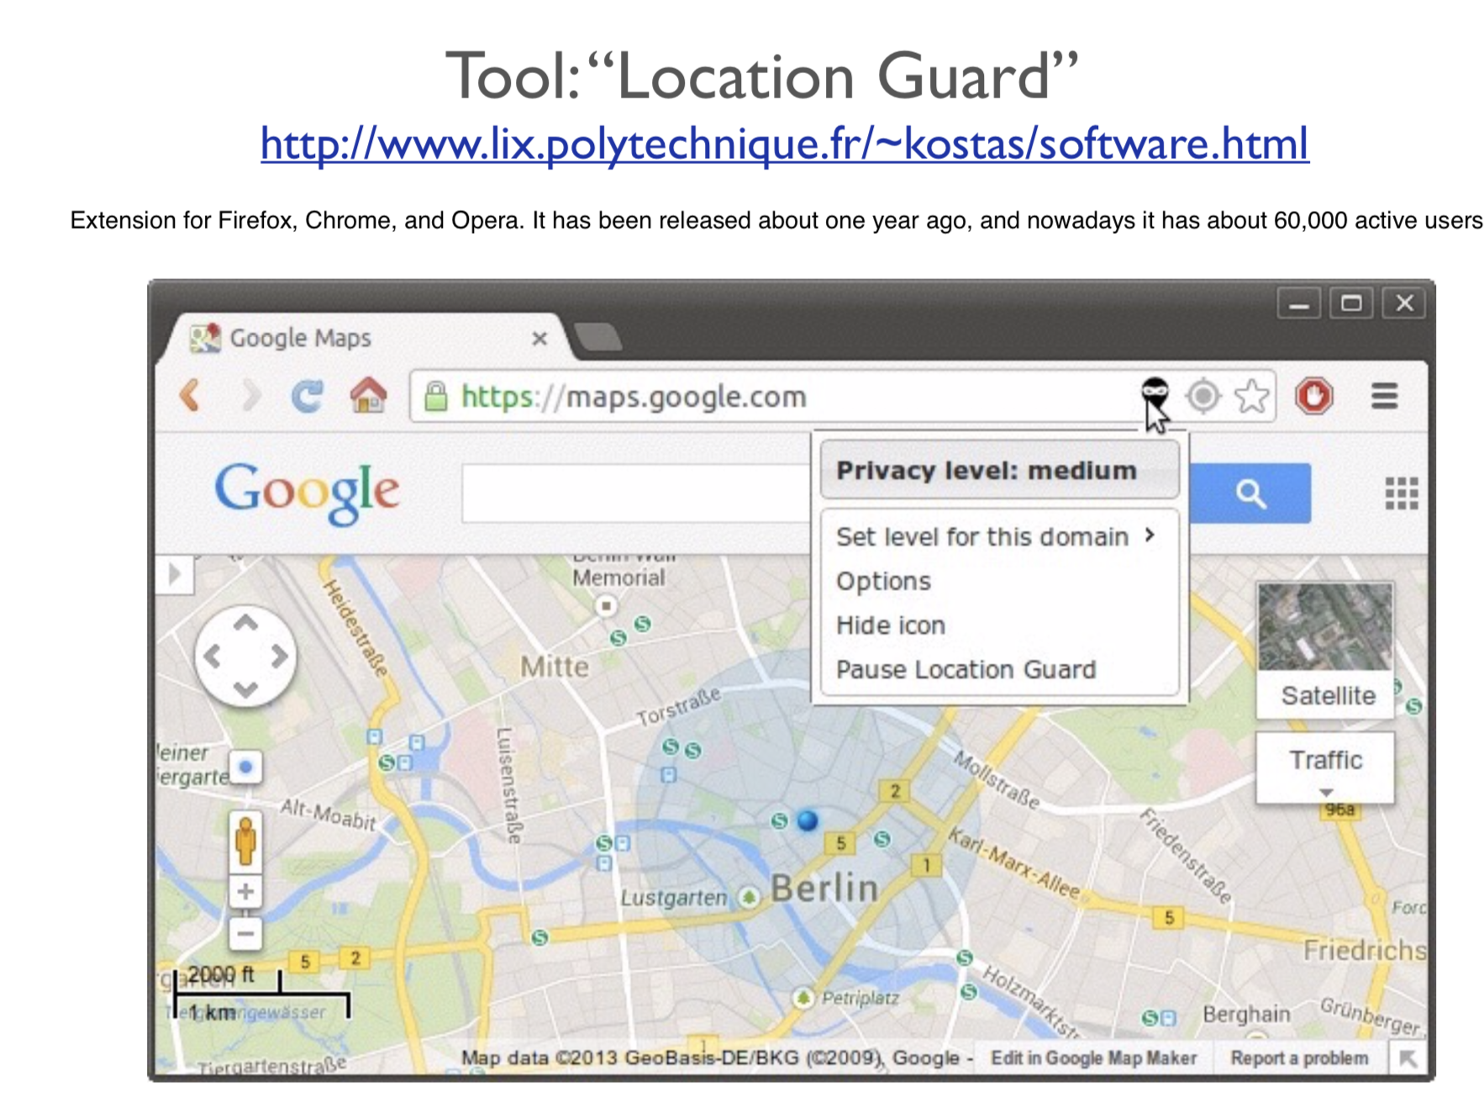

Slide 30

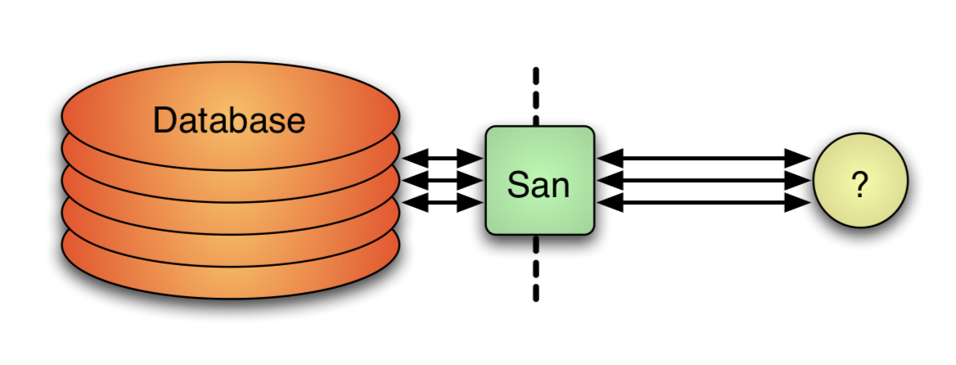
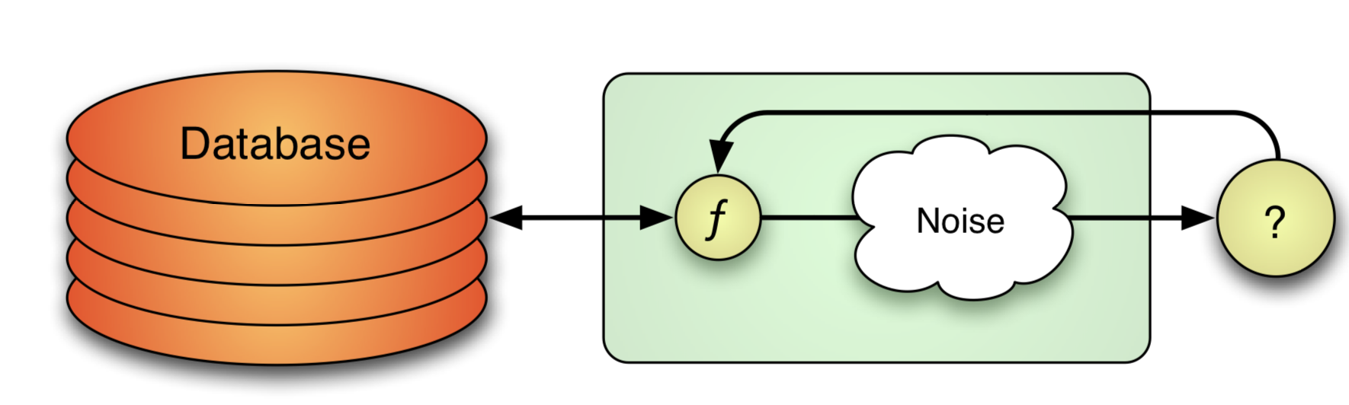
Privacy Preserving Data Mining
Methods that allow for knowledge extraction from data, while preserving privacy

Slide 31
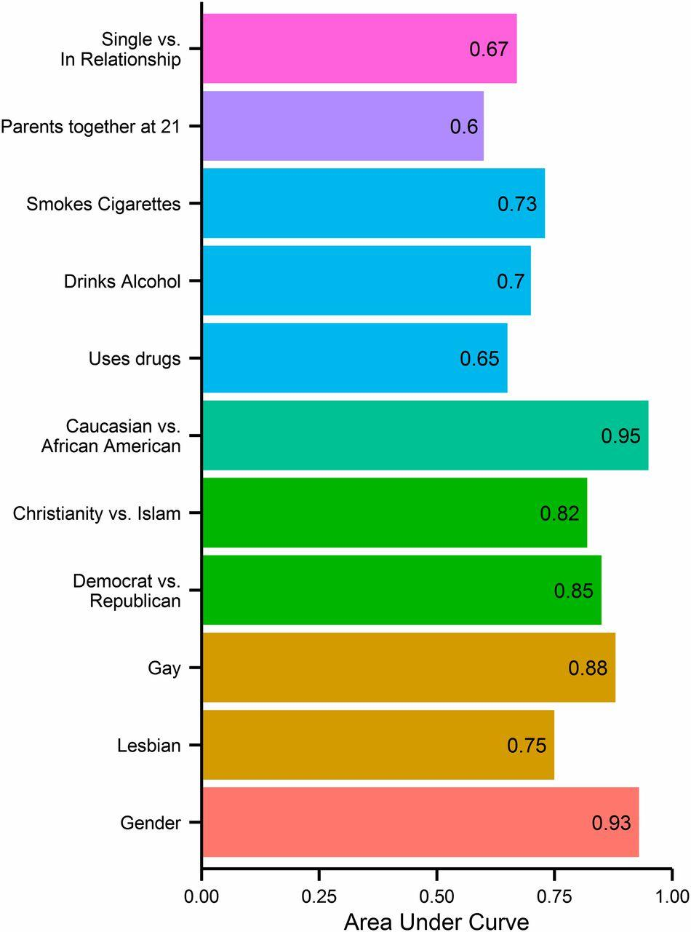
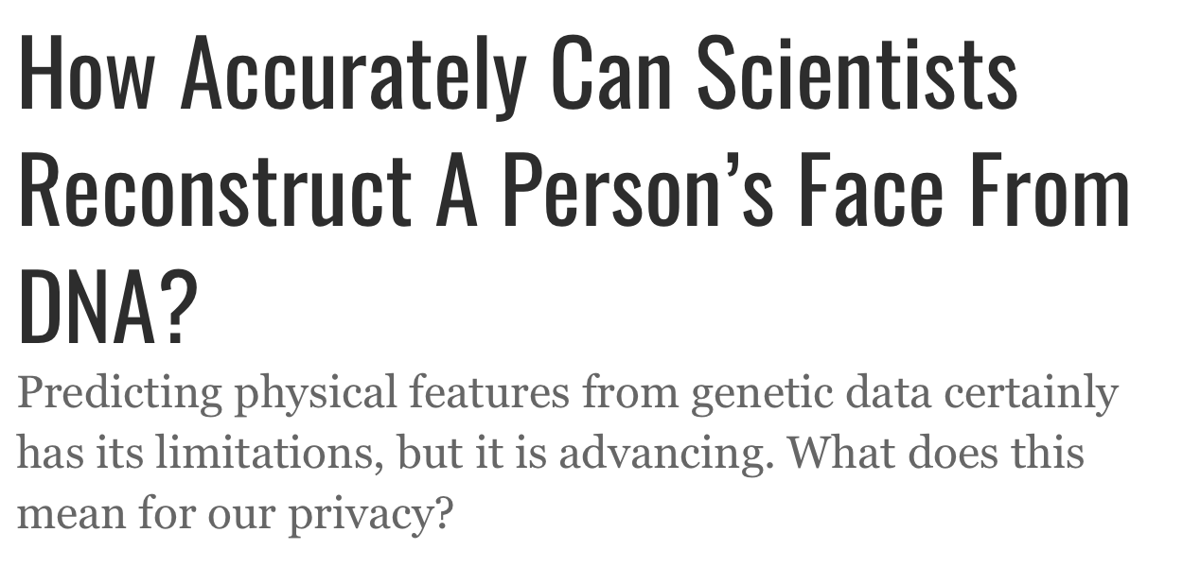
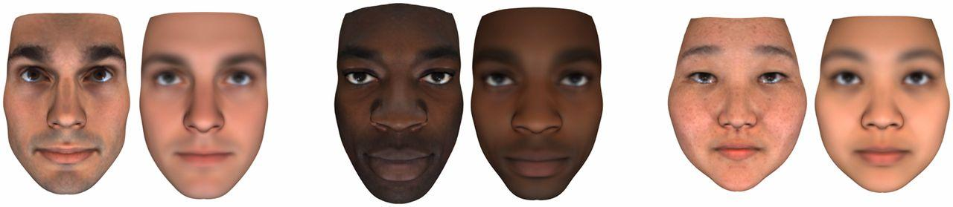
The Power of Inference
→ Unintentional disclosure is central to conversations on privacy today
Kosinski et al. (2013)

Slide 32
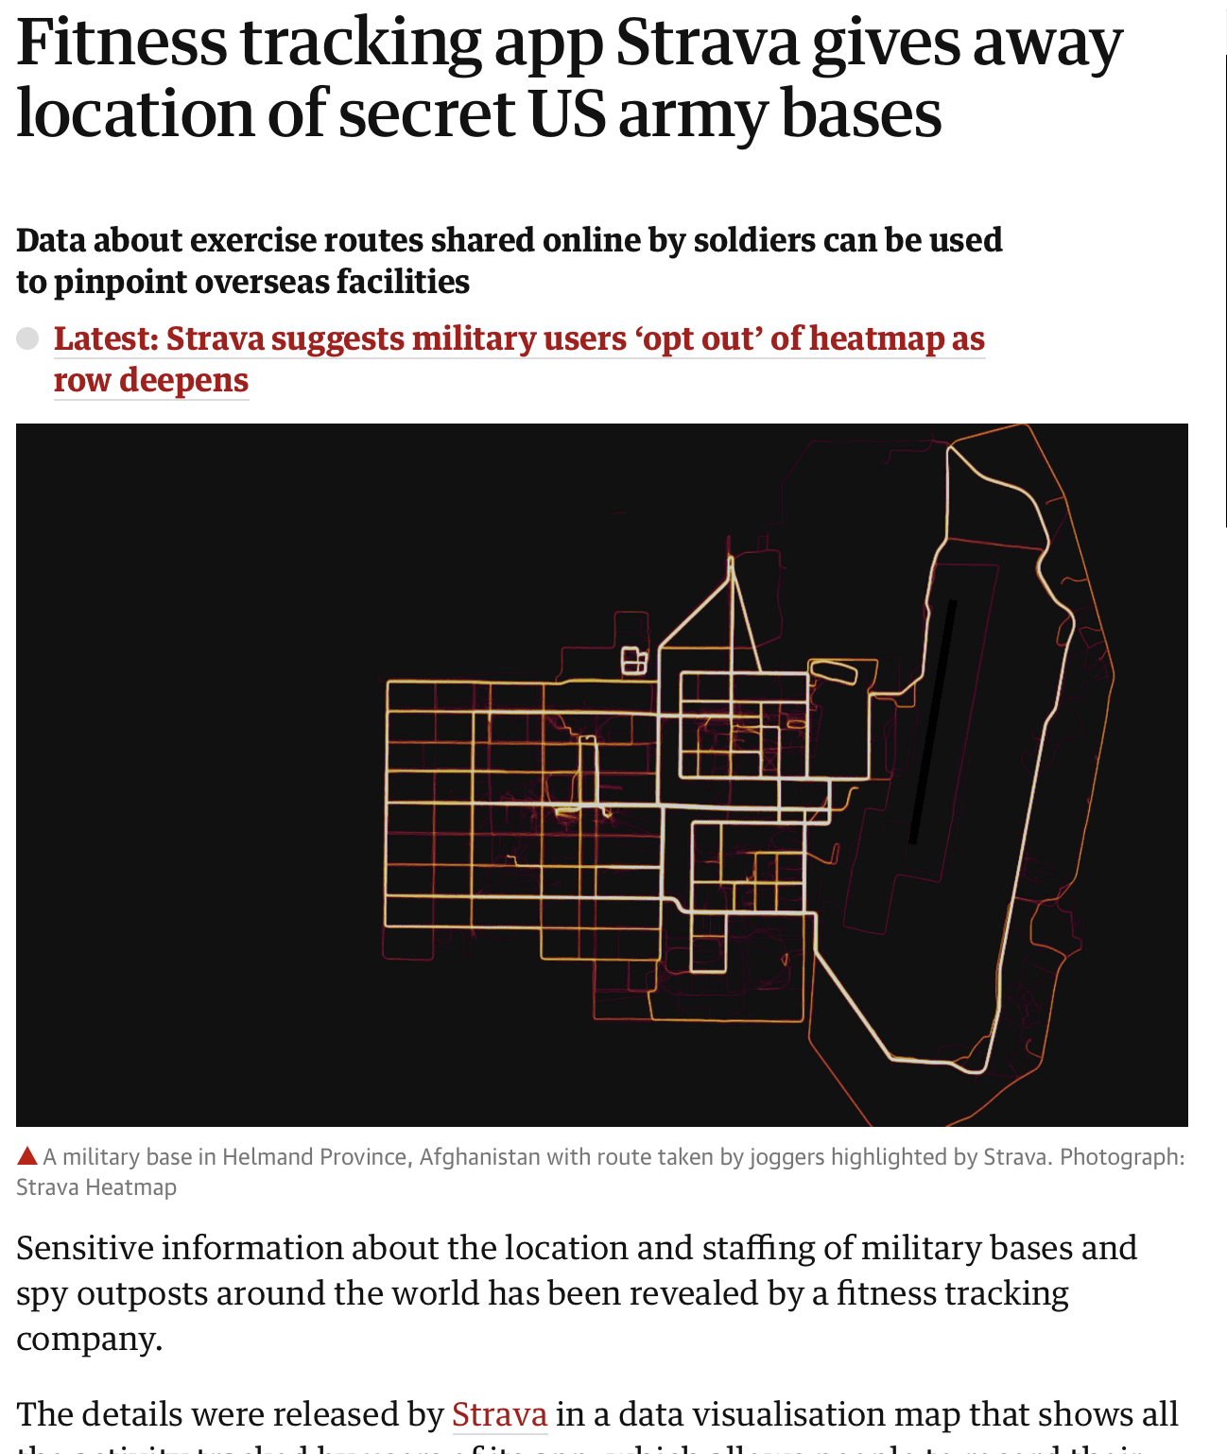
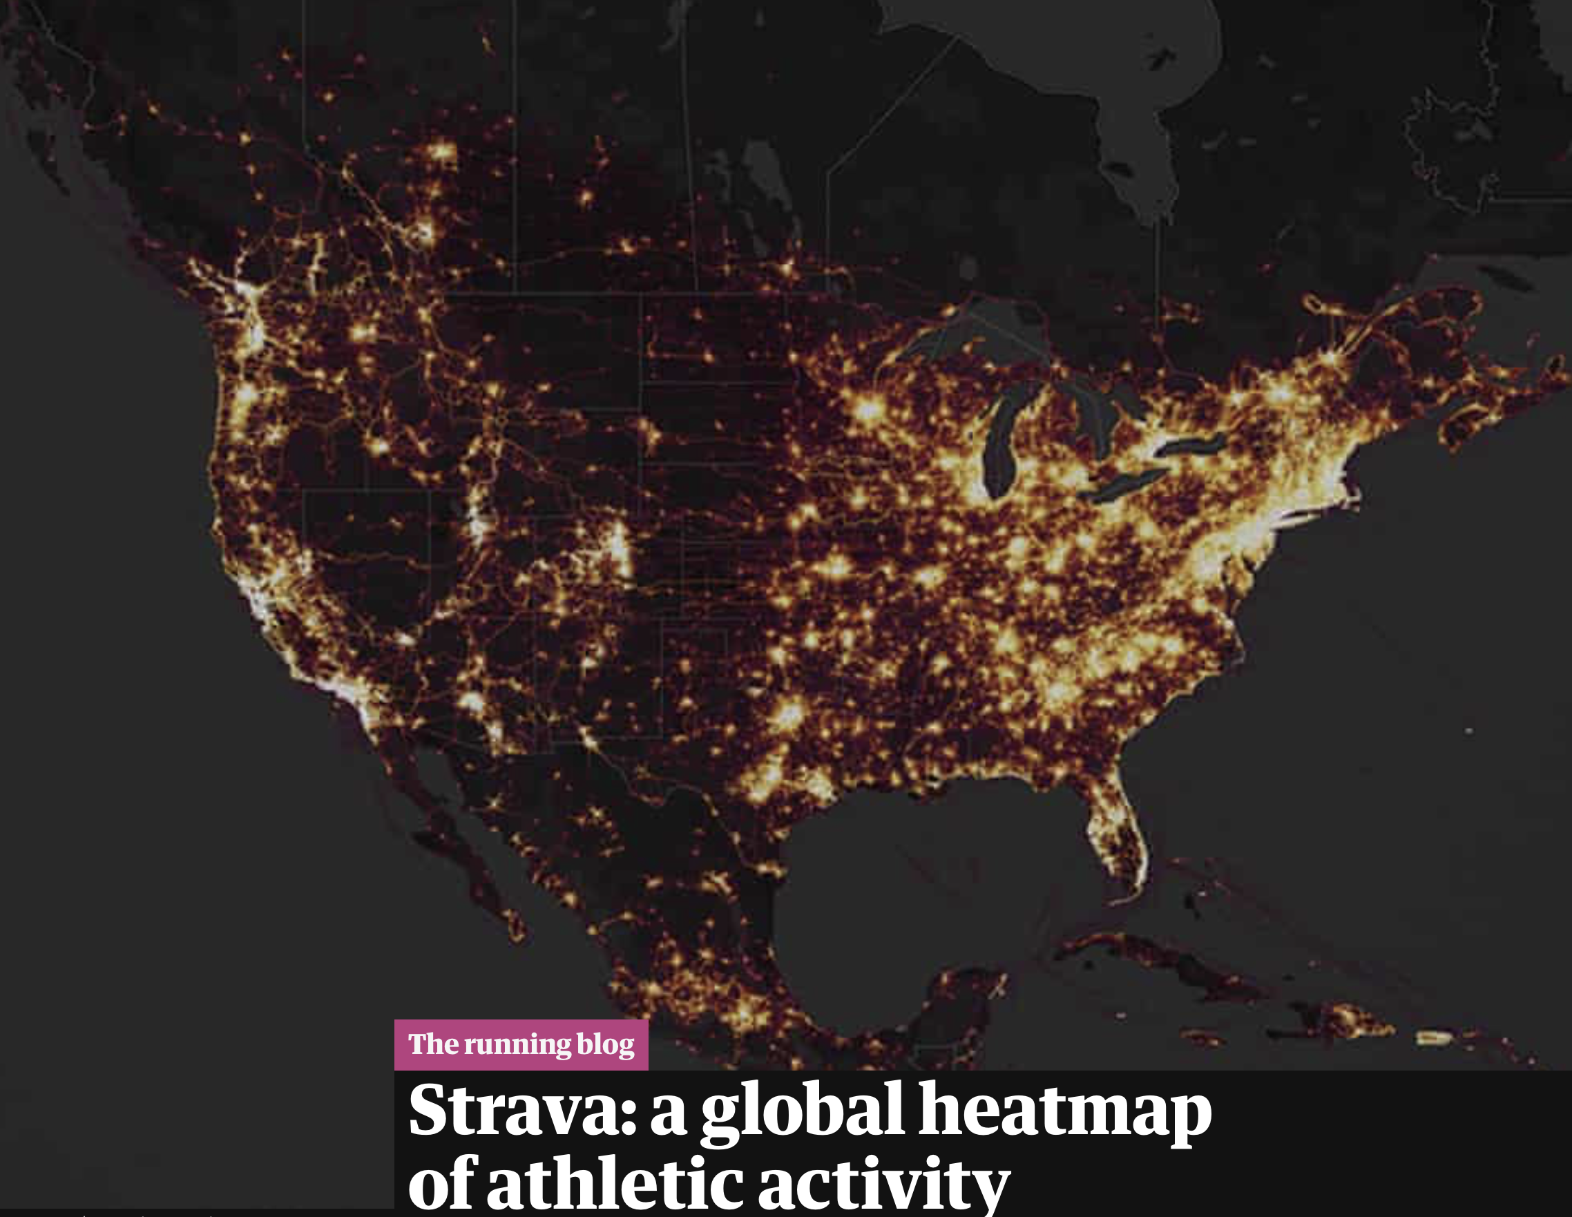
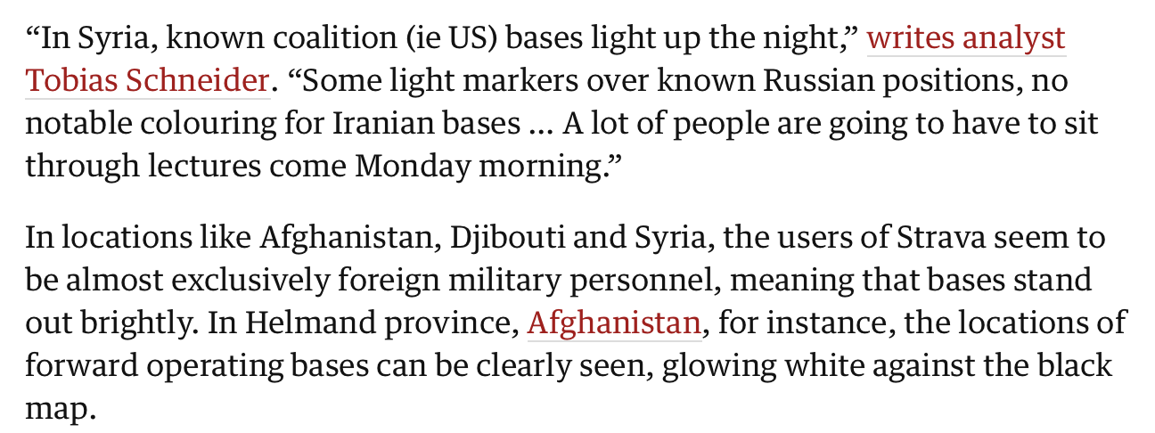
Group vulnerability
November 2017 – Strava (fitness tracker) releases a map showing every activity ever uploaded to Strava (more than 3 trillion individual GPS datapoints)

Slide 33
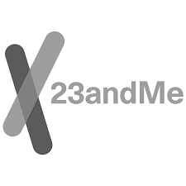






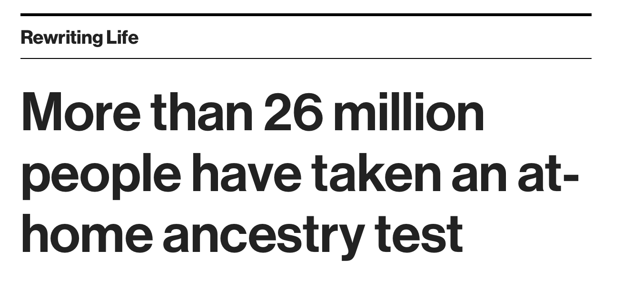

Direct-to-consumer DNA testing
All this data leads to amazing insights…

Slide 34
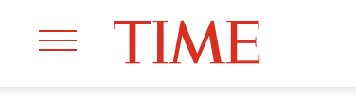
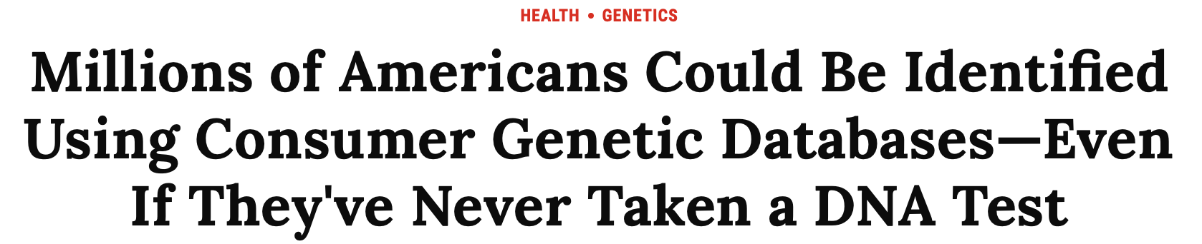

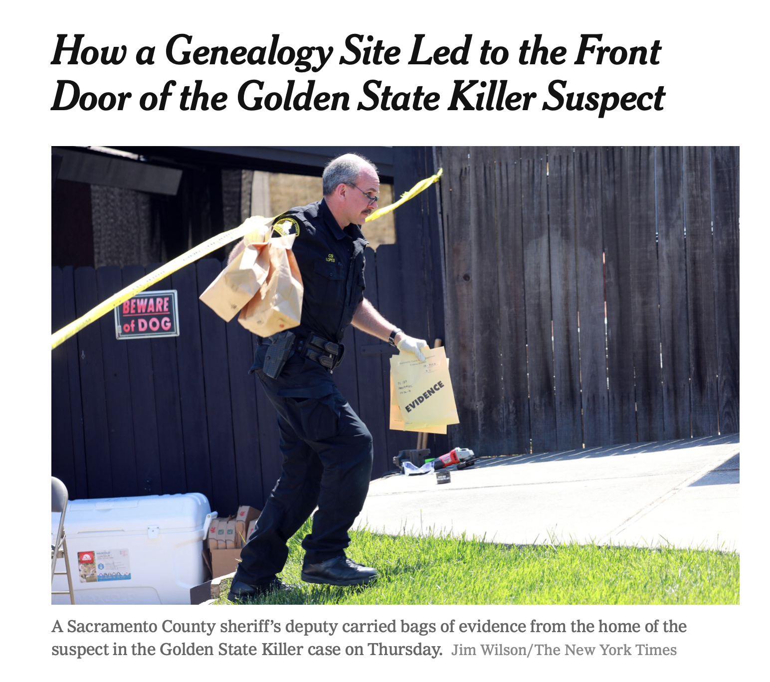
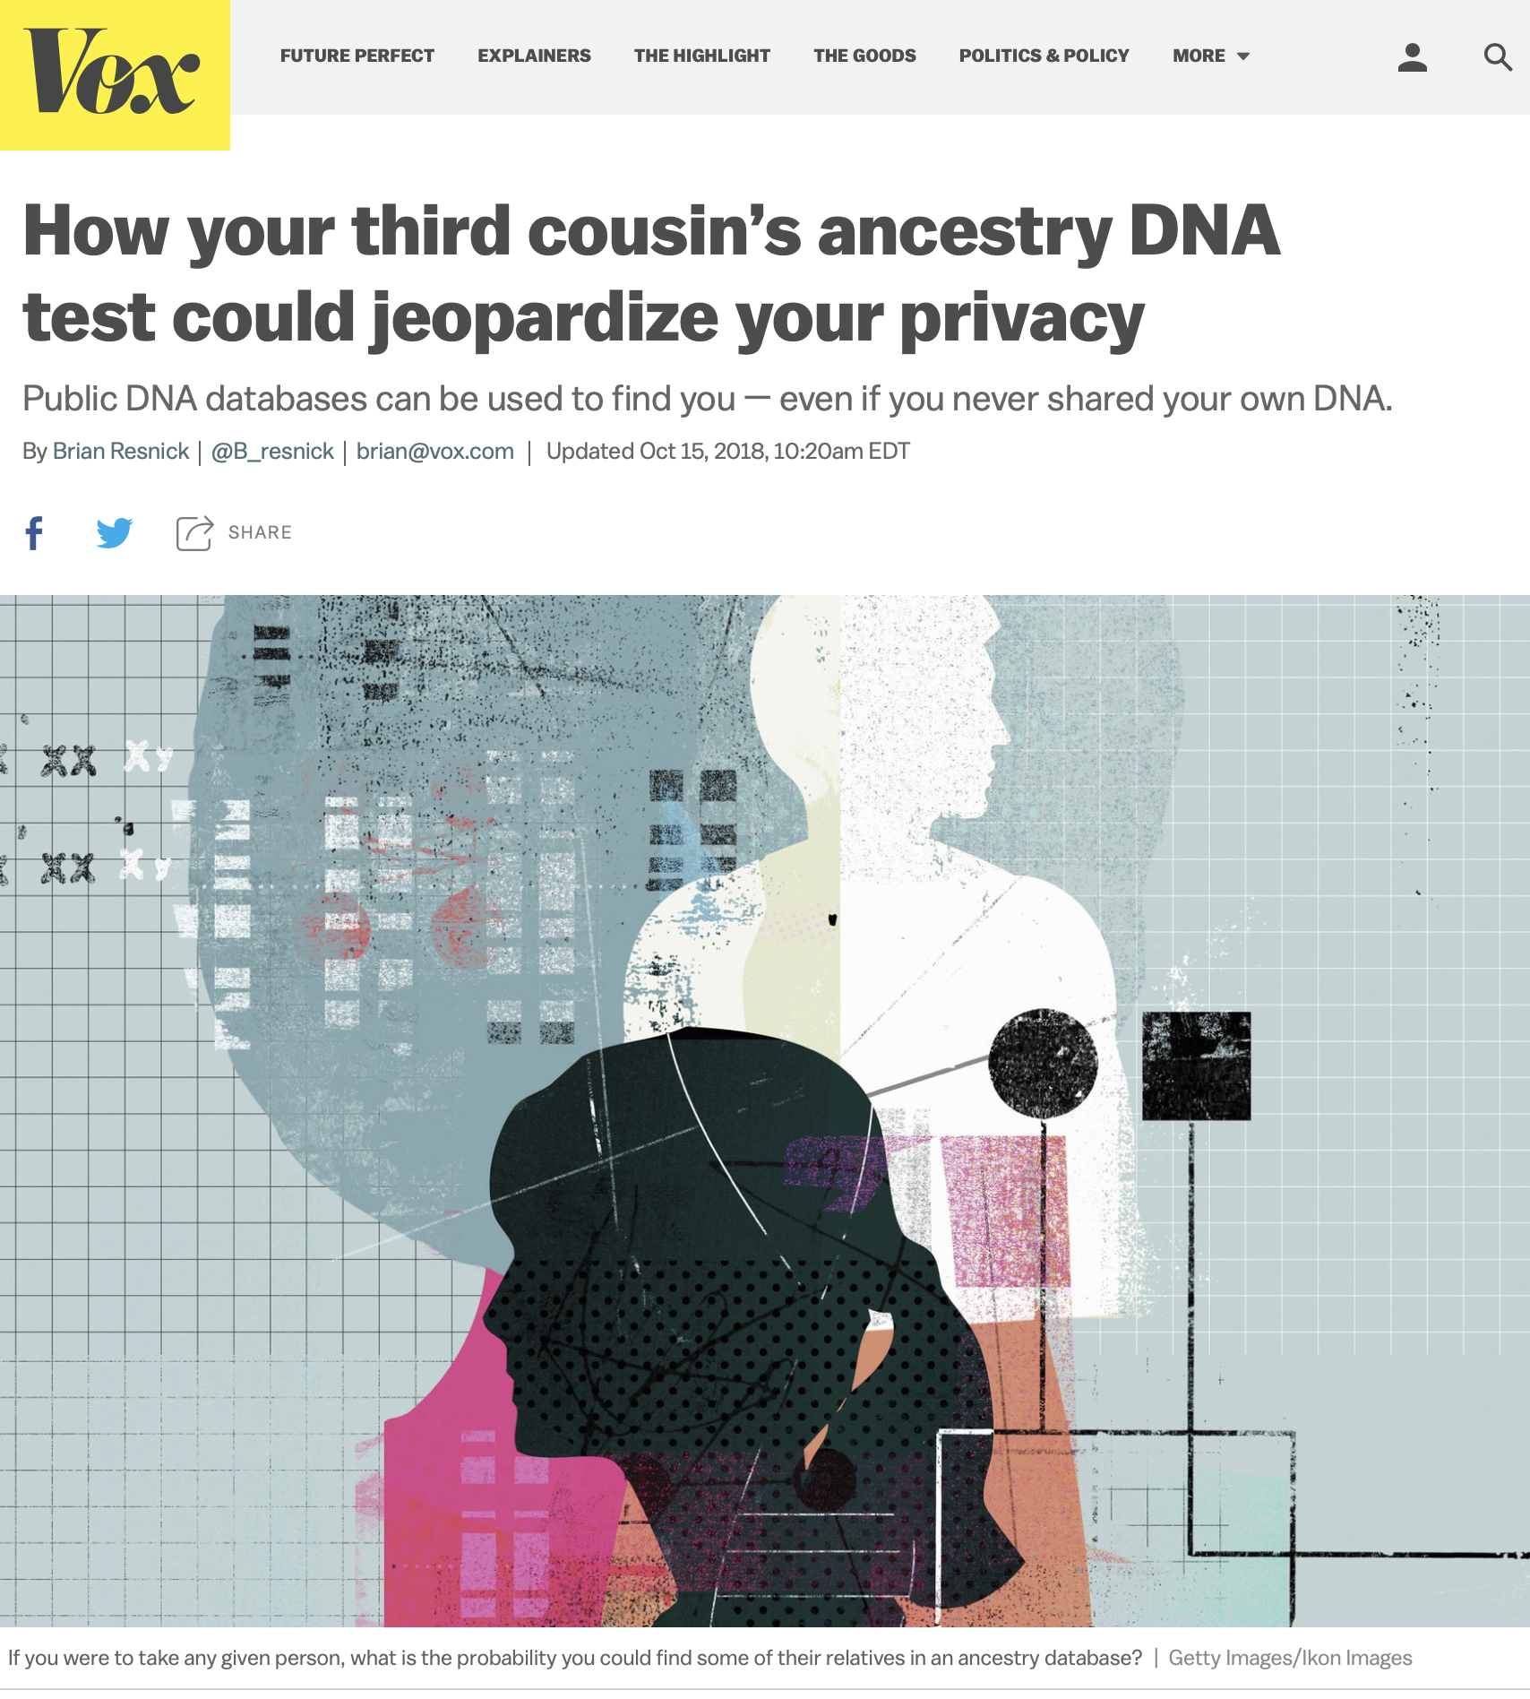
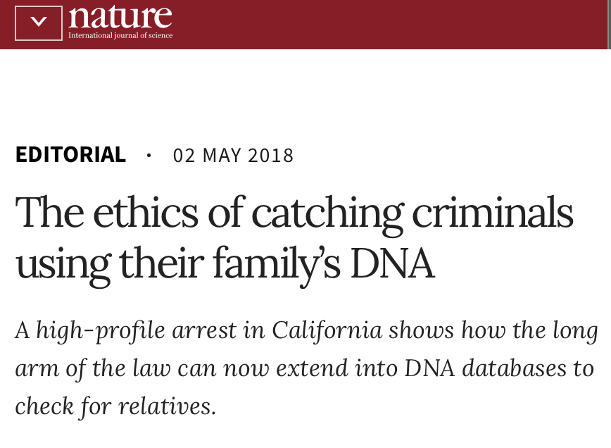
Has some upsides?
But has also sparked serious concerns.

Slide 35
Some emerging topics in information privacy:
→ genetic privacy
→ Internet privacy
→ privacy vs. security (surveillance)
→ privacy in IoT/smart homes
→ transactional databases (e.g., recommender systems)...
….you will be picking one to present (more after the break)

Slide 36
10-minute break

Slide 37
Syllabus and Expectations

Slide 38
Baseline Expectations
1. Come to class and pay attention – it will significantly impact how you do in the class.
i.e., Do not surf the web, play games, text your partner, mom or dog.. during class.
2. Stay up to date with announcements through CANVAS.
3. Communicate in a timely manner when you have concerns.
4. Be prepared to read, code, learn.

Slide 39
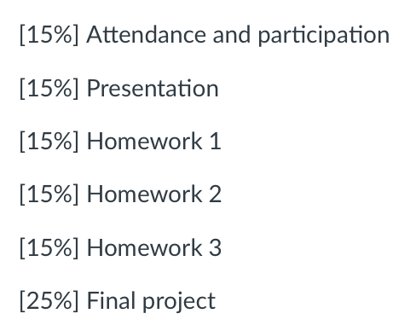
Specific Expectations – Attendance and Participation
Classroom discussion and participation is vital to everyone’s experience in this course. Regular attendance, active engagement, and thoughtful reflection on the week’s assigned readings will be assessed each week.

Slide 40
Specific Expectations – Presentation
Students will work in small groups to prepare a presentation to the class on a selected topic.
Due date will vary by student/topic.
An outline of the presentation expectations is provided in the syllabus.

Slide 41
Specific Expectations – Homework
Three homework assignments will be due on the dates listed below, covering material in Modules 1, 2, and 3. It is expected that you work independently on these assignments.
Homework 1:
Distributed 1/24, due 2/7
Homework 2:
Distributed 2/14, due 2/28
Homework 3:
Distributed 3/14, due 3/28

Slide 42
Specific Expectations – Final Project
Students will be asked to work on a research project, due the final day of class, 4/25.
A detailed outline of the project expectations is provided in the syllabus.

Slide 43
If you have partnering requests for presentations, email me by Tuesday, 1/18.
Thank you!

